Slide 1
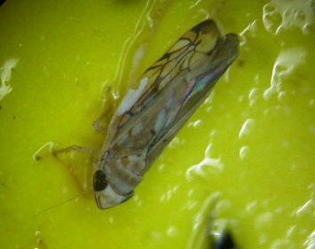
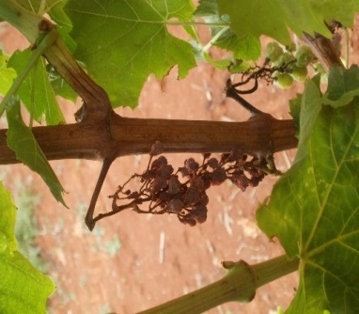
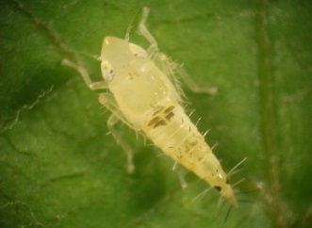
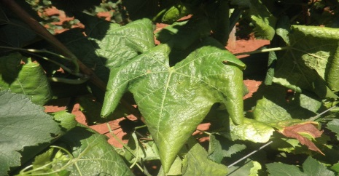
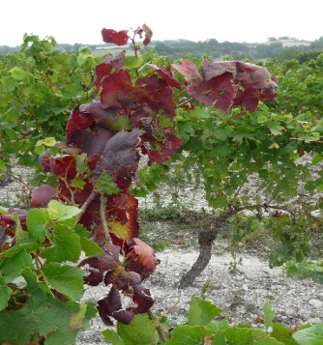
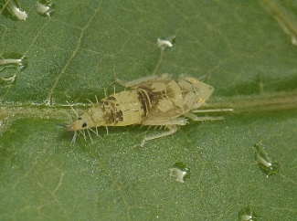
La Flavescenza Dorata L’importanza del controllo del territorio
Guida alle buone pratiche in regioni al momento esenti
Questo progetto è finanziato dall’Unione Europea nell’ambito del programma per la Ricerca e l’Innovazione Horizon 2020, convenzione No 652601

Slide 2
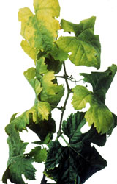
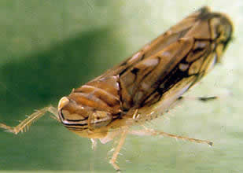
Introduzione
La Flavescenza Dorata è stata identificata nel 1950 in Francia
Malattia incurabile da quarantena
Lista A2 EPPO
Sintomi dei giallumi della vite
Combinazione tra fitoplasma, vettore e ospite
→ Rapida diffusione, importanti perdite produttive e decadimento della pianta
Notes:
The disease, caused by a phytoplasma, which is a quarantined organisms indexed on the A2 EPPO list (n°2009/297CE directive) is one of the most damaging diseases in the European vineyard, with strong economic consequences in the major wine-producing countries. The main known vector of FD is a leafhopper strictly associated with grapevine, who transmits the phytoplasma. FD induce severe impacts, including yield losses and vine plant dieback. Without control measures, the disease spreads rapidly, affecting up to the totality of vines in a few years. Despite mandatory control in Europe for this disease, it is still spreading and requires permanent monitoring to detect new infected areas.

Slide 3
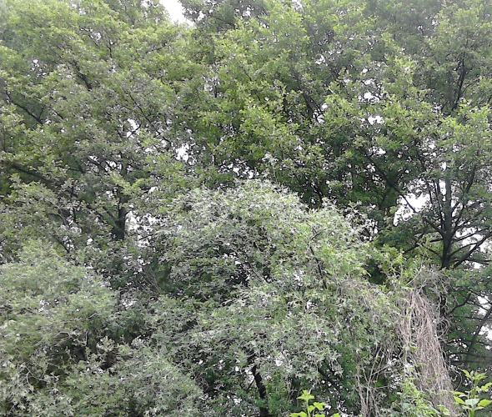
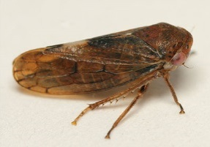
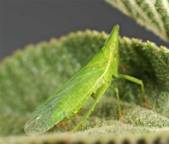
Diffusione della Flavescenza Dorata
Fitoplasma : origine europea
Vettore: cicalina chiamata Scaphoïdeus titanus importata dal Nord America
Diverse ipotesi di diffusione
Fitoplasma
FD 1, 2 e 3
Oncopsis Alni
©Tristan Bantock
Dictyophara europaea
© Dimitri Geystor
Scaphoïdeus titanus
Vitis Vinifera
Alnus , Clematis
Notes:
FD main known vector, Scaphoideus titanus, was introduced in Europe from North America in the 1950’s. Its introduction was attributed to vine plant introduction from North America.

Slide 4
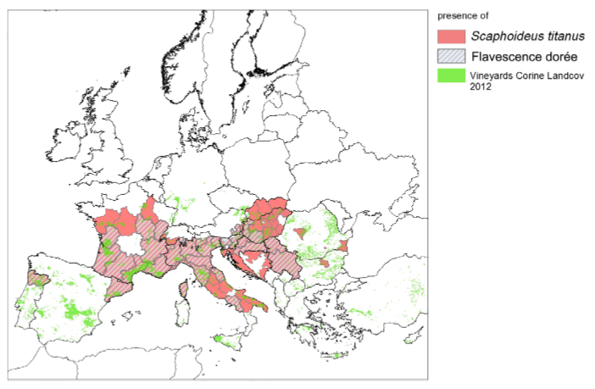
Diffusione della Flavescenza Dorata
Fitoplasma: Origini europee e diffuso da piante selvatiche alla vite
Vettore: cicalina chiamata Scaphoideus titanus importata dal Nord America
© EFSA
→ la distribuzione della cicalina è maggiore del fitoplasma
→ La cicalina S. titanus è stata trovata nel 2016 in Alsazia
Notes:
S.titanus may have already been present in 1927, but at such small spatial scale and population level that is was not recorded in inventories. The invasion of European vineyards by S. titanus is an ongoing process, the insect extended from France to most European vineyards and is now widely present in winegrowing regions from West to East from Portugal to Serbia and from North of France to South of Italy. Distribution of S. titanus in Europe is wider than the phytoplasma, insect is present in regions so far safe from FD (e.g. North of Spain or Alsace region in France). The first FD outbreak was detected in France in 1957, and then disease spreads rapidly to other European wine regions. Today the Flavescence Dorée phytoplasma is present the main wine-producing countries in Europe, namely Austria, Croatia, France, Hungary, Italy, Portugal, Slovenia and Spain Switzerland and Serbia. In some of these countries, the phytoplasma is limited to some geographical areas. The spread of the disease in Europe is strongly linked to the spread of Scaphoideus titanus, mainly based on the dispersion of introduced populations and linked to human activities. The spread of Scaphoideus titanus might not be yet ended: populations of S. titanus could become established in northern Europe or China because of favourable climatic conditions of those areas.

Slide 5
Sintomi ed effetti
Sintomi principali ma non distinguibili dagli altri giallumi
Primo sintomo
Ritardo nel germogliamento
Mancato germogliamento
In primavera
Crescita ridotta del capo a frutto
Cambiamento del colore delle foglie e arricciamento
In estate
Mancata lignificazione
Disseccamento delle infiorescenenze dei grappoli
Caduta prematura delle foglie
Colorazioni anomale delle foglie, rosse o gialle
Notes:
Grapevine infected with FD, develops symptoms that are not distinguishable from other grapevine phytoplasmas that belong into the group of grapevine yellows (GY).
Once affected by FD, grapevine shows symptoms characteristics of grapevine yellows. Early vine stages: first visible symptom can be either a delay or lack of budburst, but such observations have always to be completed later by monitoring of typical FD symptoms in summer.
In spring: symptoms of reduced growth of fruiting cane, leaf blade light curling and premature leaf fall can be observed but the more evident symptoms appear later.
In september: On infected grapevine, a lack or absence of lignification in the new shoots can be observed, with leaves curling downwards, cracking when folded in hand, and becoming reddish for red cultivars or yellowish for white cultivars. Desiccation of inflorescences and berries is observed and a premature leaf fall due to limb detachment from petiole can also occur in summer. Inside the plant, phytoplasma reduces photosynthetic activity and nutrient transport, decreasing grape quality or even causing total desiccation of bunches, involving significant yield losses (up to 100%).

Slide 6
Tipici sintomi su foglia, vitigno uva nera (fonte Regione Valle d’Aosta)

Slide 7
Tipici sintomi su foglia, vitigno uva bianca (fonte Consorzio Fitosanitario Parma)

Slide 8
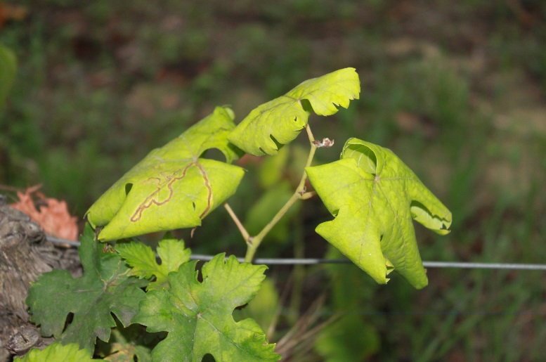
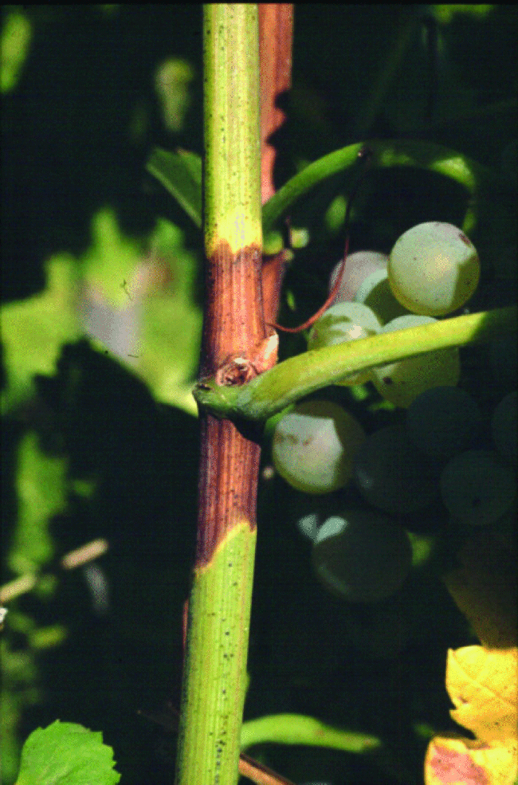
Sintomi ed effetti
In caso di dubbi
Controllare la presenza simultanea dei 3 seguenti sintomi
Colorazione anomala e accartocciamento fogliare
Mancata lignificazione
©Canadian Food Inspection Agency
Disseccamento del grappolo
Notes:
FD symptoms can be confused with other symptoms, as deficiencies or physiological disorders.
In any case of doubt, the presence of the three typical symptoms (leaf discoloration and curling, no lignification of the shoots and desiccation of bunches) must be checked

Slide 9
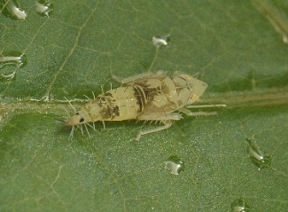
Sintomi ed effetti
Sintomi caratteristici e non distinguibili da altri giallumi
→ Più o meno visibili in base alla varietà
→ Il portainnesto può essere asintomatico
Sintomi simili alla malattia di Stolbur (Legno Nero)
→ Se esiste l’ipostesi di Flavescenza dorata, viene eseguita l’analisi PCR per identificare il fitoplasma
Notes:
Symptoms can be more or less visible according to the cultivar, furthermore, rootstocks are asymptomatic (healthy carriers of FD phytoplasma).
Then laboratory analysis can be performed if a doubt subsists for a FD case. As FD symptoms are similar to Stolbur symptoms, a PCR analysis can determine which phytoplasma is responsible for the observed symptoms. PCR method allow to diagnose and identify phytoplasma inside grapevine organs (leaf blade and petiole) by analysing DNA fragment

Slide 10
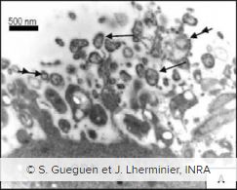
Gli attori della malattia
Agenti infettanti: Fitoplasma FD 1, 2 e 3
Batterio intracellulare senza parete che vive nei tubi floematici
→ Trasmesso da un vettore o tramite innesto
3 gruppi genetici causano la Flavescence dorata:
FD1, situato soprattutto nel sud-ovest della Francia
FD2, gruppo maggiore dell’Europa
FD3, principalmente in Italia
Ospiti selvatici: Alnus and Clematis
Fitoplasma
Notes:
The phytoplasma causing FD show genetic diversity: several phytoplasma strains can cause FD and are distributed throughout Europe. Till now, 3 genetics groups of FD phytoplasma are identified in Europe
Host-plants can serve as phytoplasma reservoirs, as Alnus glutinosa, Clematis vitalba and wild Vitis species. In Europe, the mainly accepted hypothesis is that those FD-related phytoplasma were hosted in those plants prior to grapevine.

Slide 11
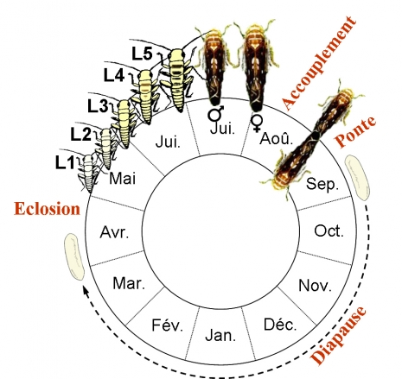
Gli attori della malattia
2) Il vettore: Scaphoideus titanus
Ciclo vitale
Solo una generazione per anno
Le larve solitamente restano sulla pianta da dove sono schiuse
Gli adulti sono molto mobili e volano da vite a vite
accoppiamento
ovoposizione
Schiusura
Diapausa
©Cuche
Notes:
Scaphoideus titanus is a univoltine species.
Eggs are laid in late summer under the bark of old wood, then after a diapause stage of 6 to 8 month depending on climatic conditions and vineyard characteristics, eggs hatch. Hatching period duration is related to diapause, which does not require cold temperatures to break.
Hatching period duration is varying according to the regions and long hatching periods are typical of vineyards with mild winters. Temperatures regulate the beginning and the length of hatching period as well as the sex ratio. After hatching, 5 nymphal instars follow each other in 5 to 8 weeks according to climatic conditions before adult appearance. Nymphs usually stay on the plant where they hatch but sometimes jump from one plant to another. They feed preferentially on suckers at the basis of the trunk or on the lower and inner leaves. Adults appear generally from July, are highly mobiles and fly from vine to vine. In order to mate, Scaphoideus titanus emits vibratory communication signals. Females, if mated, are able to start laying eggs 10 days after emergence (maturity at 6 days after emergence).

Slide 12
Gli attori della malattia
2) Il vettore: Scaphoideus titanus
Comportamento alimentare
Un insetto con apparato boccale pungente e succhiante che si nutre sulle foglie di vite
L’acquisizione del fitoplasma è possibile dal primo stadio larvale
Un mese di incubazione e poi infettivo tutta la vita
Notes:
Scaphoideus titanus feeds on grapevine leaves. It is generally admitted that Scaphoideus titanus is mostly feeding in the phloem vessels, but it can probe sap either in the phloem or in the xylem. Nymph prefer to feed on small veins of the leaf blade and adults feed more on the larger veins or petioles. From the first nymphal instar, S. titanus can acquire the phytoplasma when feeding on infected plants, and then remain infected for the rest of its life. An incubation delay of one month is required for the vector to become infectious. During this period the phytoplasma circulates and multiplies in the leafhopper to reach the salivary glands where multiplication rate is even higher. Once the concentration of phytoplasma in the salivary glands is sufficient, the infectious agent may be transmitted to a healthy plant for every intake.

Slide 13
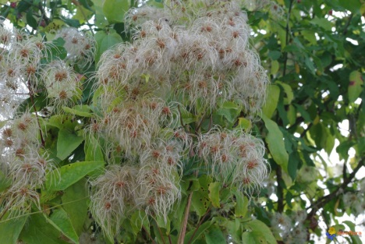
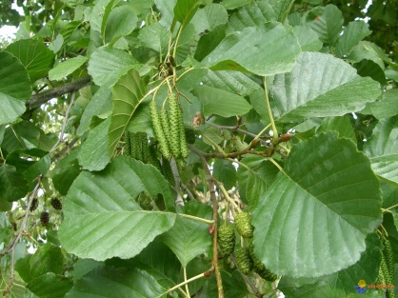
Gli attori della malattia
3) L’ospite: la vite
Scaphoideus titanus dipende dalla vite: la cicalina può svolgere il suo ciclo vitale solo su Vitis vinifera
→ malattia molto epidemica
Il fitoplasma è presente in altre piante selvatiche: Alnus or Clematis
→ Associate con altri vettori: possibile trasmissione
Oncopsis Alni
©Tristan Bantock
Dictyophara europaea
© Dimitri Geystor
Clématis vitalba
© Visoflora
Alnus glutinosa
© Visoflora
Notes:
In Europe, S. titanus is strongly associated to Vitis vinifera but can be occasionally found on other plants as Salix viminalis and Prunus persica. The insect accomplish its entire life cycle on grapevine but can occasionally feed on other plants. S. titanus could have varietal preferences: in multivarietal vineyard different population level were observed on each variety.
S. titanus is associated to grapevine but FD phytoplasma can be found in other species as Alnus glutinosa, Clematis vitalba, Ailanthus altissima... Other vector species, as the planthopper Dictyophara europaea and the leafhopper Oncopsis alni, can transmit the phytoplasma from these species to grapevine. But this phenomenon seems very occasional, then transmission probability is low as these vectors are very rare feeders on grapevine unlike S. titanus
When a vine plant is infected, phytoplasma colonizes all the parts of the plant via the phloem and constitutes therefore a source of infection. By feeding on grapevine and moving from grapevine to grapevine, S. titanus spread the disease. Therefore, the infection rate in year N is strongly correlated to vector populations in year N-1. Without insecticide treatment, S. titanus populations in vineyard can reach a magnitude range of thousands of individuals per hectare leading to a fast spread of the disease, with an increasing number of infected vines up to 10-fold every year!

Slide 14
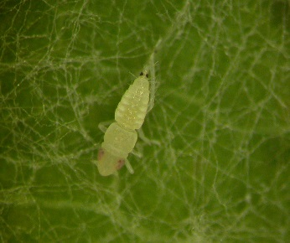
Prospettive e monitoraggio
Riconoscimento della cicalina
2 punti simmetrici in posizione dorso-laterale
Stadi larvali : L1 sulla sinistra, L3 in centro e L5 sulla destra
Colore marrone
Dimensione tra 4.8 e 5.8 mm
3 strisce sulla testa delle femmine
Scaphoïdeus titanus
Notes:
Scaphoideus titanus is hard to detect and to recognize, because nymphs are small and mobiles.
Furthermore, the leafhopper can be confused with other leafhoppers or insects living on grapevine.
Early stages of S.titanus nymphs are first white colour to translucent, and then stain with ageing. Nymphs are identifiable thanks to two symmetrical black points in dorsolateral position near abdomen posterior end. Nymphs, when disturbed, show a typical behaviour: they tend to jump away. This behaviour can be used to discriminate S.titanus nymphs from other leafhopper juvenile forms that should be present at the same time on the grapevine leaves, such as Empoasca vitis (when disturbed moves laterally on the leaf surface) and Zygina rhamni (when disturbed show to move along a straight line on the leaf surface).
Scaphoideus titanus adult size range from 4,8 to 5,8 mm, has brown colour and stripes on the head.

Slide 15
Prospettive e monitoraggio
Rilievo della cicalina
Possibile dal primo stadio larvale da tecnici esperti
Controllo visivo di 100/200 foglie, sui polloni e foglie basali
Trappole cromotropiche appiccicose per catturare gli adulti della cicalina in vigneti o su viti inselvatichite
Trappole cromotropiche usate da IFV
Notes:
Monitoring the vector is helpful to detect any new presence of S. titanus. Monitoring can start on S.titanus nymphs but requires trained technicians. To be precise enough, visual control should be performed on 100 to 200 leaves underside and on grapevine basal shoots and leaves avoiding moving excessively the vegetation because the leafhopper jump away. Finding Scaphoideus titanus does not mean that there is FD in the area but mean that there is a risk for future FD outbreak. The plot needs to be monitored during the season and insecticides treatments can be applied as preventive measure to prevent infection.
Monitoring of S.titanus can be done more easily on adults by positioning sticky traps in the vineyard, inside plots and close to areas with wild vines.
Monitoring FD vector can help to prevent FD infection and in a case of infection to take necessary measure rapidly. In vine areas close to winegrowing regions with confirmed presence of Flavescence Dorée disease, monitoring vectors is highly significant.

Slide 16
Prospettive e monitoraggio
Prevenire infezioni agendo su potenziali serbatoi
Potenziali serbatoi di vettore: viti inselvatichite e altre piante come Clematis or Alnus:
Rischio di emergenza epidemica
MA anche importante per la biodiversità ed ecosistemi
→ Ragionare in base alla situazione
Notes:
Wild vines and other species represent a reservoir for Scaphoideus titanus, and for FD phytoplasma. FD phytoplasma has been reported on wild species as Clematis and Alnus and may be transmitted occasionally to grapevine.
This so-called “wild compartment” thus presents a known risk of epidemic emergences. However, he could also supply services at the vineyard: reservoir of biodiversity, natural regulation of some pests by auxiliaries. Thus, it’s important to consider and estimate the relationships between epidemic risk and services of natural regulation which offer these semi-natural areas. So, beyond the perimeter of the vineyard itself, the extension of the monitoring and disease control in these wild compartments is not easy.

Slide 17
Prospettive e monitoraggio
Monitoraggio del territorio
Preoccupazione di tutti gli attori→ monitoraggio collettivo
Segnalazione obbligatoria di casi di FD → confermare la diagnosi e informare le autorità locali
Analisi di laboratorio per identificare il fitoplasma
Notes:
objective of monitoring : to inventory the sanitary status of vineyards and agricultural fields and to monitor appearance and spread of new harmful organisms.
Control of visible symptoms on Vitis vinifera cultivars has to be implemented at the vineyard scale, by winegrowers on their own vineyard or at larger scale for a regional vineyard with collective prospecting. It is important that all stakeholders of the vine and wine sector are involved in monitoring and are aware of damages caused by Flavescence Dorée. Areas without FD need to be protected from infection and monitoring is a major key to prevent outbreaks.
Winegrowers need to be trained on symptoms recognition as well as specialized technicians who will monitor territory at a large scale. Where FD is known for present, a dedicated plan could organize the monitoring of the territory paying a specific attention to rootstocks as those can carry FD phytoplasma without showing any symptom.
In case of FD introduction in new areas, previously marked as uninfected, control and eradication measures must be applied in correspondence with European, national and regional laws. Indeed, as a result of the FD quarantine status, report of symptomatic plants potentially infected with Flavescence Dorée phytoplasma is mandatory in every winegrowing region of Europe.
Collection and analysis of symptomatic grapevines samples can complete visual observations and is the only way to distinguish FD phytoplasma from Stolbur phytoplasma.
Who to inform in case of symptoms detection?
If FD symptoms are detected in a vineyard area, local technicians should be asked to confirm the potential FD case before reporting to official authorities.
How to be sure?
FD and Stolbur are expressing similar symptoms on vine. In order to distinguish between those two diseases, and even from other possible confusing causes of the observed symptoms, an analysis has to be performed in accredited labs.
Who to inform in case of vector introduction?
If vector is detected in a vineyard area, an entomologist or specialized technician should be asked to confirm the leafhopper species before reporting to official authorities.

Slide 18
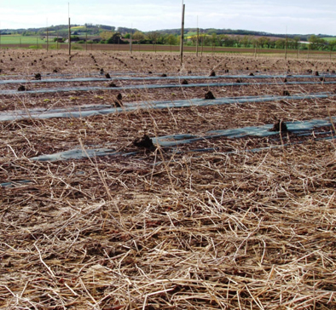
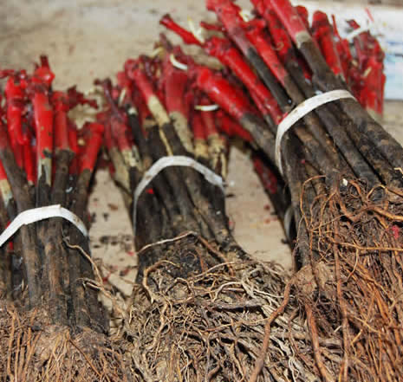
Uso di materiale propagativo sano
3 possibilità per la diffusione della malattia:
Circolazione di materiale vivaistico infetto
Trasporto del vettore infetto
Trasferimento da piante selvatiche
Vivaio:
→ Monitoraggio di piante madri
→ HWT (trattamento con acqua calda)
Notes:
In areas free from FD nurseries can implement special activities to prevent FD phytoplasma infection as hot water treatment and a conscientious monitoring of mother-vines.
In Europe, according to the country or region, there are specific rules regarding nurseries as mandatory hot water treatment, and, in some cases, prohibition to manage nursery activity in FD outbreak regions.
Management in nurseries
In nursery, monitoring should be focused in controlling symptoms development on the mother plants, both mother plants of rootstocks (healthy carriers) and scions by regular observations. Any symptomatic plants should be registered and uprooted. In case of detection, local competent authorities should be informed. Flavescence Dorée vector, S.titanus should be also monitored on mother-vines by preventive nymphs and adult monitoring. Furthermore, diagnosis tools of phytoplasma detection should be implemented.
Hot water treatment
Hot water treatment (HWT) allows the eradication of the FD phytoplasma from propagation material and can be used to prevent infected material to enter the area. Hot water treatment need to be applied on scions or grafted rootlings in controlled conditions: plants are immerged in a bath of hot water for 45 minutes at 50°C. Combination of time and temperature is the most important factor in HWT efficiency and need to be such as suppress phytoplasmas without affecting vine development. If combination of 50°C for 45 minutes is not respected, buds can present localized cellular degeneration and total alteration up to 60°C.
Purchasing hot water treated material is strongly recommended to European growers, in particular for regions where FD is not present yet. In presence of the vector, a single infected plant can generate a wide infection.

Slide 19
Conclusioni
Malattia grave, rapida diffusione e ingenti perdite economiche
Alcune aree sono esenti, ma il monitoraggio è fondamentale
Consapevolezza e coinvolgimento di tutte le parti interessate nel settore assicura prospettive migliori
Notes:
Flavescence Dorée is a serious disease, and if not properly managed spreads rapidly and causes important economic losses for the wine sector. In Europe, areas spared from FD remain. But the vector is spreading fast and with it the disease. In regions free from FD, monitoring vineyard is essential to prevent introduction of Flavescence Dorée vector. In the presence of the vector, a single infected plant can generate a wide infection. Raising awareness of sector’s stakeholders is important in the prevention of FD outbreaks, by education on diseases epidemiology, symptoms and risks.

